Slide 1
Prepping for Climate Change: Quantifying Outdoor Water Savings as a Function of Weather
Miguel A. Morales, PhD, EIT
October 14, 2020

Slide 2
City of Austin, Texas
Serves a population of 1.1M
Projected to quadruple in next 100 years
Draws water from the Colorado River into three regional water treatment plants (combined capacity of 335 MGD)
Located in Central Texas between the deserts of the SW and the more humid SE
Long, hot summers – short, mild winters
Annual average of 34” of rain, wettest during spring and fall

Slide 3
Weather Variables
Hourly weather data obtained from Camp Mabry
NOAA Local Climatological Data (LCD) station
Reference evapotranspiration (ETo)
Hourly temperature, relative humidity, atmospheric pressure, and wind speed used to calculate daily ETo via the Penman-Monteith method with the Hargreaves approximation for solar radiation
Aggregated up to calendar months & calibrated to local conditions and irrigation patterns using billing data
Crop coefficients (Kc) to estimate crop evapotranspiration (ETc)
Hourly precipitation aggregated to calendar months
Month | Kc
1 | 0.67
2 | 0.56
3 | 0.46
4 | 0.46
5 | 0.45
6 | 0.46
7 | 0.49
8 | 0.58
9 | 0.74
10 | 0.81
11 | 0.91
12 | 0.89

Slide 4
Historical ETo (1949-2019)

Slide 5
Historical Precip. (1949-2019)

Slide 6
GPCD & Weather

Slide 7
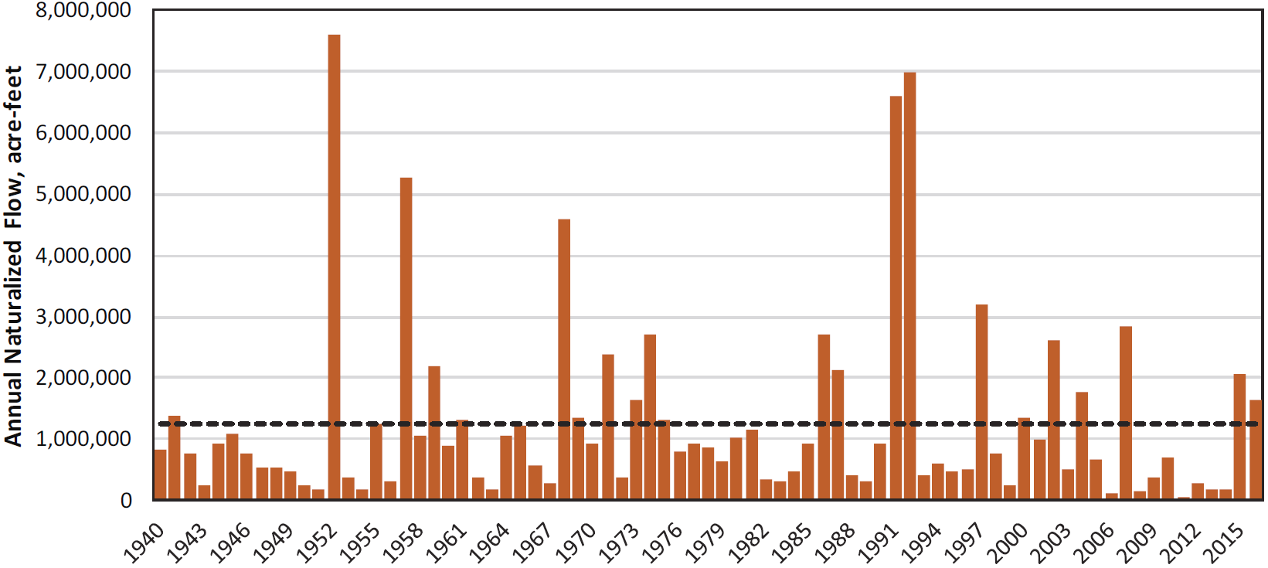
Annual Flow of Colorado River @ Austin
Austin Water – Water Forward – Integrated Water Resources Plan

Slide 8
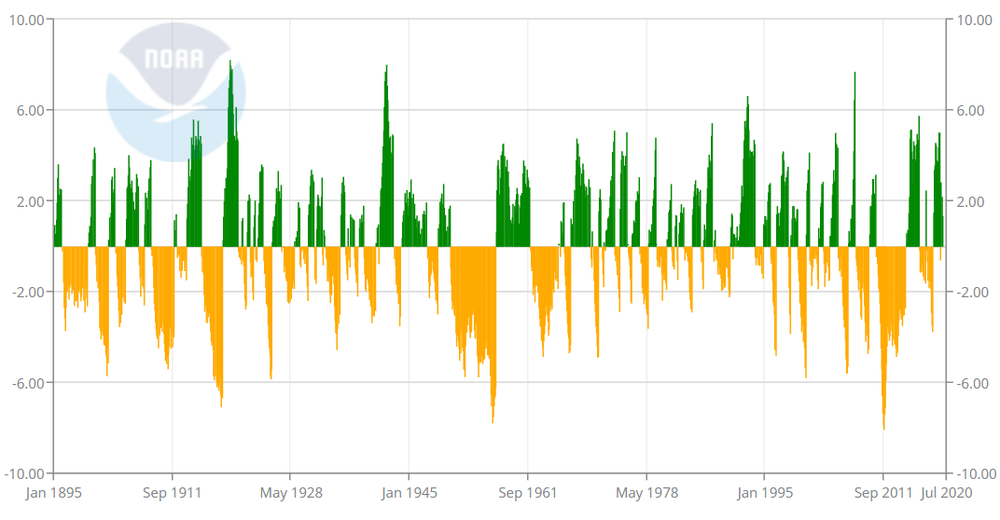
Palmer Drought Severity Index for Texas
NOAA National Centers for Environmental information, Climate at a Glance: Statewide Time Series, published August 2020 at https://www.ncdc.noaa.gov/cag/

Slide 9
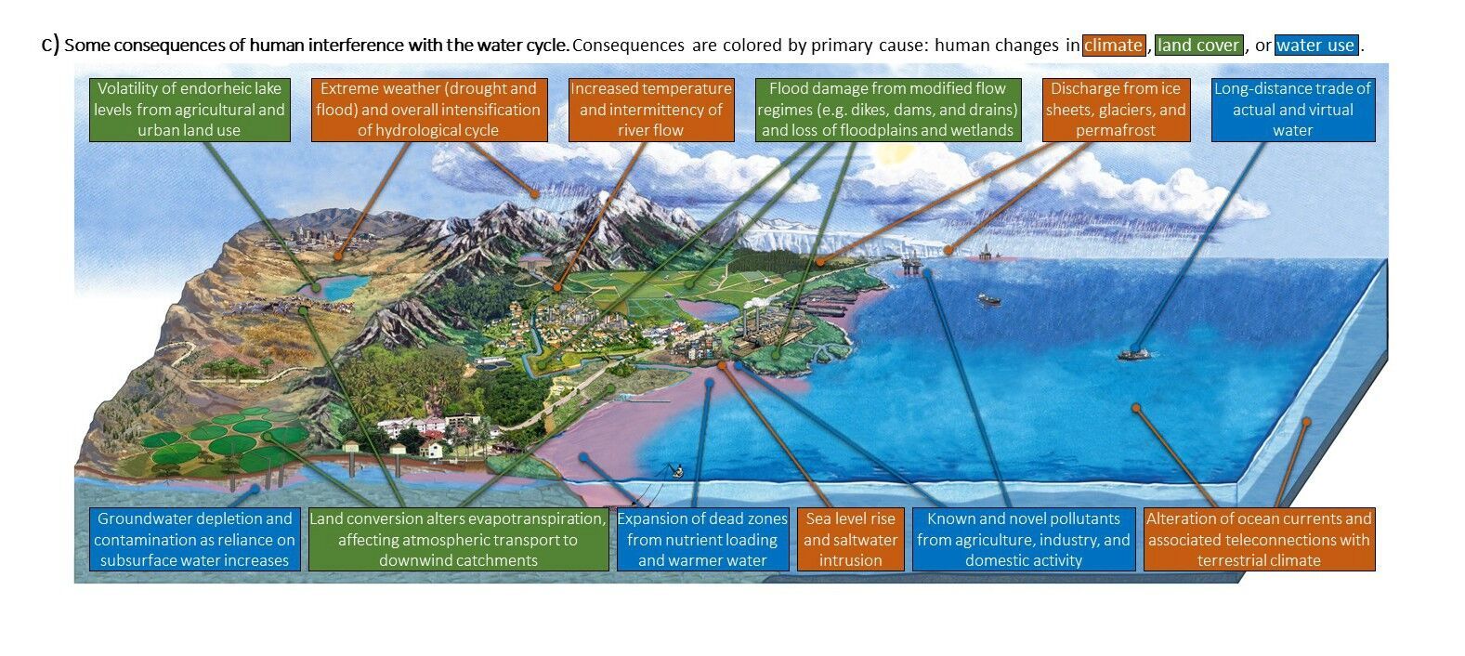
Foreseen Impact of Climate Change
Rising temperatures and evaporation rates are forecast to accelerate the hydrologic cycle and increase the intensity of heavy precipitation and severity of droughts
Heightened tradeoff between water supply and flood protection
University of Birmingham, Brigham Young University, and Michigan State University

Slide 10
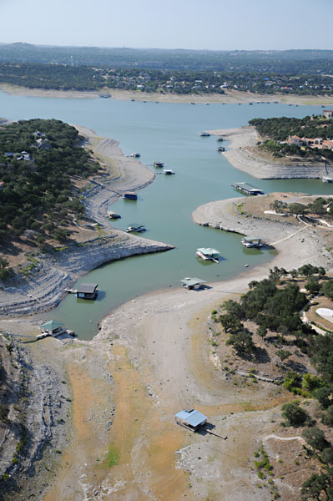
Adjusting Conservation Savings Rates
Not enough to focus on average savings rates
Important to understand savings when they matter most
Peak days – drive infrastructure expansion
Droughts – water supplies most taxed
Jack Newton
LCRA

Slide 11
Capacity-Based Rainwater Harvesting Rebate (RWH)
Started in 2010
Offers rebate based on rainwater storage capacity
$0.50/gal capacity for non-pressurized systems
$1.00/gal capacity for pressurized systems
From 2010-2018:
2,555 rebates given to 2,395 customers
$980k in rebates for $3.33M spent by customers
1.64 million gallons of rainwater storage capacity

Slide 12
Single-Family Residential (SFR) Participation
Type | Total Customers | Total Rebates | Avg. Conservation Activities per Customer | Avg. Rebate Amount | Avg. Amount Spent by Customer | Avg. Rainwater Storage Capacity (gal)
Non-Pressurized | 2,223 | 2,371 | 1.93 | $197 | $707 | 389
Pressurized | 173 | 176 | 1.77 | $3,127 | $10,124 | 4,431
Total | 2,396 | 2,547 | 1.92 | $409 | $1,387 | 681

Slide 13
Watering Restrictions
Twice-a-week watering restrictions implemented in May 2008 in response to historic drought
Alternated between once-a-week, twice-a-week, and no restrictions in subsequent years
Once-a-week restrictions made permanent in September of 2012

Slide 14
Data Filters to Isolate RWH Effect
Post-2012 billing (remove transition into permanent watering restrictions)
Continuous billing (remove homes that were unoccupied for extended periods of time)
Same customer throughout (attempt to isolate agent and associated behavioral components)
No other conservation activity (attempt to further isolate impact of RWH)
Control group with same filters (attempt to isolate effect of passive conservation)
Based on SFR from same Census Blocks which did not participate in RWH or any other conservation activity
Billing data rectified or adjusted to calendar months

Slide 15
Non-Pressurized RWH
 | Participants | Control
Parcels | 275 | 4,236
Avg. People per Home | 2.49 | 2.49
Year Built | 1976 | 1975
Building Area (sf) | 1,946 | 1,896
Pervious Area (sf) | 8,655 | 7,991
Appraised Value | $462,439 | $456,402

Slide 16
Non-Pressurized RWH
Time series regression on the aggregate does not show statistically significant water demand reduction associated with non-pressurized rainwater harvesting

Slide 17
Non-Pressurized RWH

Slide 18
Non-Pressurized RWH
Weather Condition | ETc (in/d) | Participants (GPCD) |  |  | Control (GPCD) |  |  | Participants / Control
 |  | Pre-RWH | Post-RWH | % Diff. | Pre-RWH | Post-RWH | % Diff. | Pre-RWH | Post-RWH | % Diff.
Avg. Winter Min | 0.05 | 53 | 43 | -19.9% | 68 | 53 | -21.5% | 78.4% | 79.9% | 1.6%
Avg. Annual | 0.09 | 73 | 61 | -16.7% | 89 | 76 | -15.5% | 82.1% | 80.9% | -1.3%
Avg. Summer Max | 0.13 | 112 | 98 | -12.2% | 128 | 120 | -6.8% | 87.3% | 82.2% | -5.5%

Slide 19
Pressurized RWH
 | Participants | Control
Parcels | 16 | 256
Avg. People per Home | 2.42 | 2.42
Year Built | 1965 | 1968
Building Area (sf) | 2,546 | 2,293
Pervious Area (sf) | 14,416 | 11,768
Appraised Value | $788,225 | $685,101

Slide 20
Pressurized RWH
Time series regression on the aggregate again does not show statistically significant change in water demand associated with pressurized rainwater harvesting, though less so!

Slide 21
Pressurized RWH

Slide 22
Pressurized RWH
Weather Condition | ETc (in/d) | Participants (GPCD) |  |  | Control (GPCD) |  |  | Participants / Control
 |  | Pre-RWH | Post-RWH | % Diff. | Pre-RWH | Post-RWH | % Diff. | Pre-RWH | Post-RWH | % Diff.
Avg. Winter Min | 0.05 | 61 | 51 | -17.6% | 82 | 60 | -27.0% | 74.8% | 84.5% | 9.4%
Avg. Annual | 0.09 | 88 | 85 | -3.3% | 111 | 94 | -15.6% | 78.9% | 90.4% | 12.3%
Avg. Summer Max | 0.13 | 140 | 168 | 19.6% | 166 | 170 | 2.3% | 84.6% | 99.0% | 17.3%

Slide 23
Conclusions & Future Work
Important to understand the impact of weather on water demand to compare usage patterns and evaluate conservation savings when they matter most
Test case highlights the weather dependency of outdoor water savings and offers some interesting results:
Non-pressurized RWH: slight increase in usage in cooler months, larger decrease in usage in hotter months
Pressurized RWH: increased usage throughout the year, though much more so in hotter months (creating new demand?)
Improve sample sizes and further explore panel regression
Incorporate likely climate change scenarios into long-term planning

Slide 24
Contact:
Miguel.Morales@austintexas.gov
512-974-3545

